Slide 1
The Assessment of Improved Water Sources Across the Globe
By Philisile Dube

Slide 2
Data and Variable Used
Data from the World Bank and United Nations
Examining data for 30 countries over a period of 10 years (2000-2009)
Variables include:
- Improved water source (% total population)
- GDP per Capita (US $)
- Agricultural Land (% of land area)
- CO₂ Emissions (Metric tons per capita)

Slide 3
Hypotheses
GDP per Capita (US $) and Years: Positive association with response variable
Agricultural Land and CO₂ Emissions : Negative association with response variable

Slide 4
Correlation Test
H₀: ρ = 0 versus H₁: ρ ≠ 0
where ρ is the correlation between a pair of variables
Improved Water Source Years GDP per Capita Agricultural Land
Years 0.060
0.297
GDP per Capita 0.504 0.034
0.000*** 0.554
Agricultural Land 0.150 -0.003 -0.260
0.009** 0.957 0.000***
CO2 emission 0.536 0.005 0.813 -0.057
0.000*** 0.930 0.000*** 0.325
Cell Contents: Pearson correlation
P-Value

Slide 5
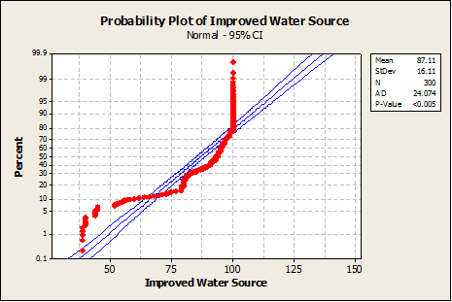
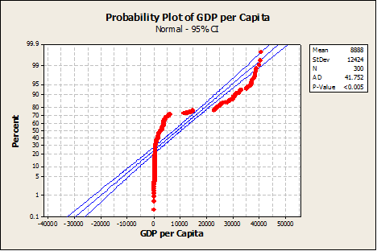
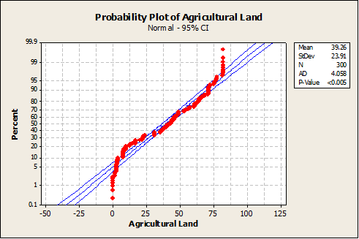
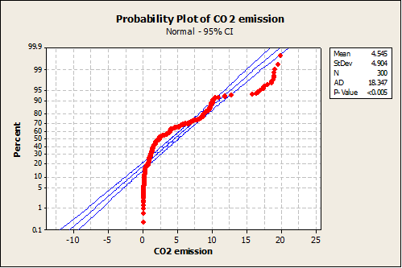
Normality Test for Variables

Slide 6
Parametric Regression Hypothesis
H₀: β1 = β2 = β3 = β4 = 0 ( all coefficients are not important in model )
H₁: at least one of β1, β2, β3, β4, is not equal to 0
Regression model is based on a distribution of F with df1 = k and
df2 = n – (k+1).

Slide 7
Full Parametric Regression Model
Improved Water Source = - 462 + 0.267 Years + 0.000465 GDP per
Capita + 0.174 Agricultural Land +
0.853 CO2 Emissions
Adjusted R-Squared : 35.3 %
F-Statistic : 41.71 on 4 and 295 DF, P-value: 0.000***

Slide 8
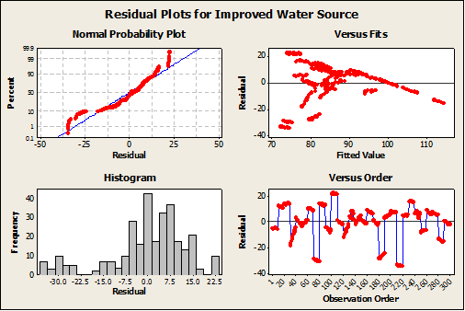
Residual Plots

Slide 9
Reduced Parametric Regression Model
Improved Water Source = 72.3 + 0.000471 GDP per Capita
+ 0.174 Agricultural Land +
0.841 CO2 Emissions
Adjusted R-Squared : 35.2 %
F-Statistic : 55.25 on 3 and 296 DF, P-value: 0.000***

Slide 10
Nonparametric Regression Hypothesis
H₀: β1 = β2 = β3 = β4 = 0 and ξ unspecified (No significant role in Y-variable)
H₁: β1, β2, β3, β4, at least one does not = 0, and ξ unspecified
HM statistic has an asymptotically chi-squared distribution with q degrees of freedom, where q corresponds to the constraints under Ho
HM statistics = 2D*J/τ
D*J = DJ(Y-Xβo) – DJ(Y-Xβ), equivalent to (Reduced – Full Model)
= Hodges-Lehmann estimate of tau.

Slide 11
First Nonparametric Regression Model
Improved Water Source = - 334 + 0.208Years + 0.000326GDP per
Capita + 0.0467 Agricultural Land +
0.575 CO2 Emissions
τ = 12.97 HM₁ = 102.70
Reject H₀ if HM₁ ≥ χ²_{q, α}
χ² _{4, 0.001} = 18.47 , thus we reject the null hypothesis (H₀)

Slide 12
Second Nonparametric Regression Model
H₀₃: β2= 0; β1, β3, β4, and ξ unspecified
= 12.97 HM₂ = 0.925
Reject H₀ if HM₁ ≥ χ²_{q, α}
χ² _{1, 0.10} = 2.706 , thus we fail to reject the null hypothesis (H₀₃)

Slide 13
Conclusion
Both Parametric and Nonparametric models do a good job in assessing the data.
All independent variables lead to an increase in dependent variable.
All variables were statistically significant except for the Years variable.
Future Advice: use more variables in model.

